Slide 1
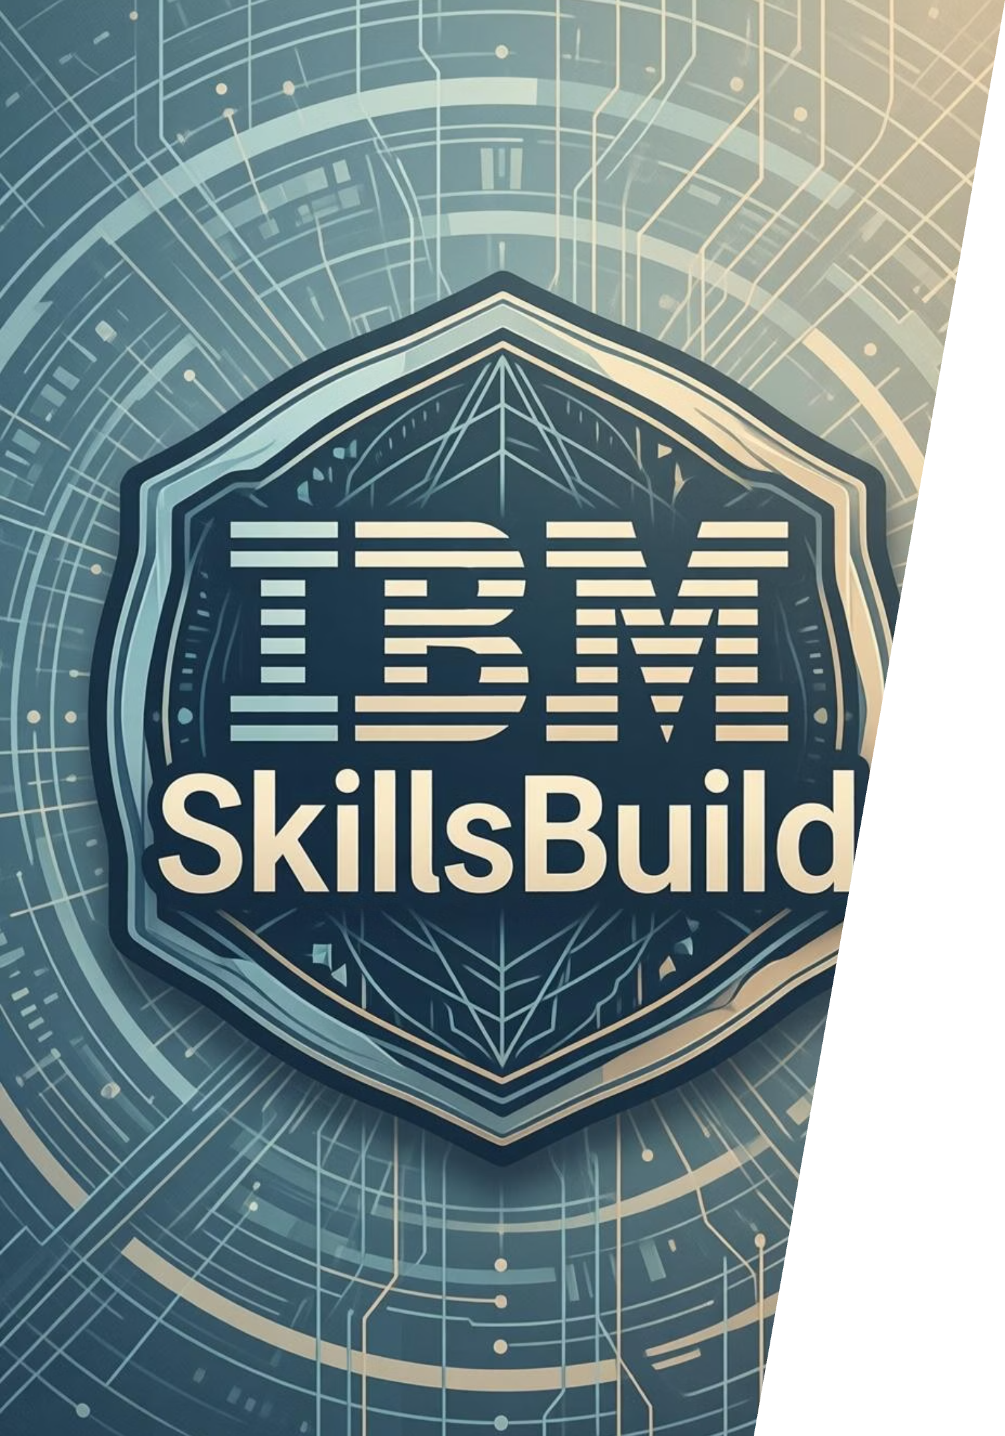
CareerFit AI: The Intelligent Resume Analyst
IBM-CSRBOX SkillsBuild Applied AI Internship | Jan 2026
Presented by: Mangesh Singh Chauhan

Slide 2





The Problem: The "Resume Black Hole"
75% Rejected
Zero Feedback Loop
Discouragement & Unemployment
A staggering 75% of resumes are filtered out by Applicant Tracking Systems (ATS) before ever reaching a human recruiter.
Job seekers receive no personalized feedback, leaving them in the dark about why their applications were unsuccessful.
This lack of transparency leads to widespread discouragement and exacerbates unemployment, directly impacting SDG 8: Decent Work and Economic Growth.

Slide 3




The Solution: CareerFit AI
Your Personal AI Recruiter
CareerFit AI is an innovative Agentic AI tool designed to simulate a strict technical recruiter, providing invaluable insights to job seekers.
Input
Process
Output
Users upload their resume (PDF) and paste the job description they are targeting.
Utilizing Google Gemini 2.5 Flash, CareerFit AI performs a deep semantic gap analysis.
Provides a real-time "Match Score" and specific, actionable upskilling advice.

Slide 4
Under the Hood: Technical Architecture
CareerFit AI is built on a robust and modern technology stack to deliver accurate and timely analysis.
Core Logic
LLM Engine
Frontend
Developed with Python 3.12, ensuring high performance and maintainability.
Powered by Google Gemini 2.5 Flash via API for advanced natural language processing.
An intuitive and responsive user interface built using Streamlit.
Analytics
Data Parsing
Visualizes data effectively with Plotly, especially for dynamic Gauge Charts.
Efficiently processes PDF resumes using the PyPDF2 library.

Slide 5
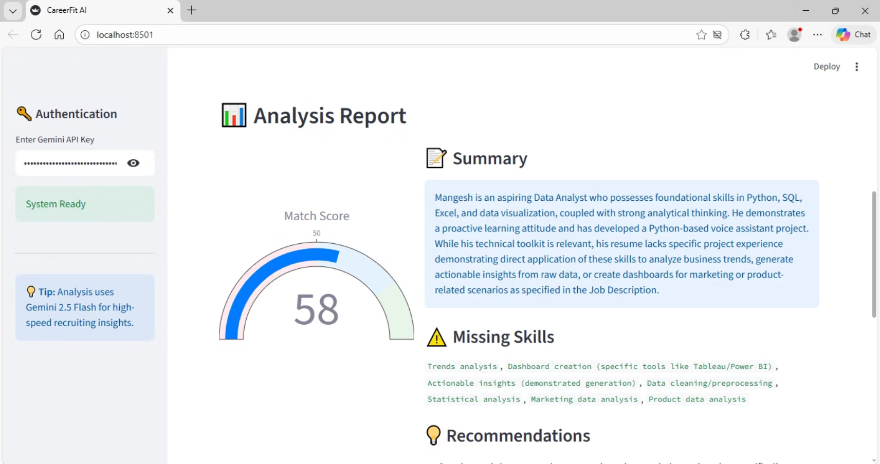
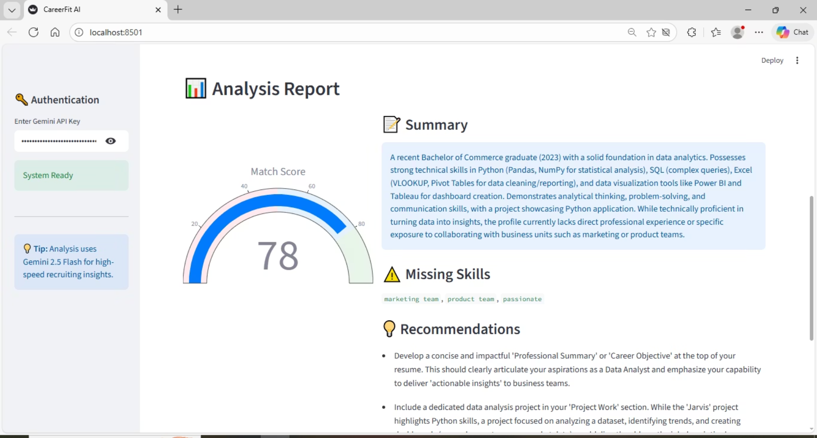
Proven Results: Before vs. After
BEFORE: 58% Match
User submitted a generic resume, resulting in a low match score due to missing keywords and relevant experience.
AFTER: 78% Match
User incorporated suggested skills (e.g., SQL, PowerBI), significantly boosting their employability score.
This demonstrates how targeted advice from CareerFit AI can dramatically improve a candidate's chances.

Slide 6

Impact & Scalability
CareerFit AI is designed not just for individual users, but for broader societal impact.
Massive Scalability
Democratizing Coaching
Enhancing Employability
The platform can process thousands of resumes simultaneously, making it ideal for educational institutions and large-scale recruitment drives.
Our mission is to make high-quality career coaching accessible and affordable for every student, regardless of their background.
By providing actionable insights, we empower job seekers to bridge skill gaps and secure better employment opportunities.

Slide 7



Future Scope: What's Next?
We envision an even more comprehensive CareerFit AI, continuously evolving to meet the dynamic needs of the job market.
Automated Resume Rewriting
AI-driven suggestions for optimizing resume content, phrasing, and formatting.
LinkedIn Profile Analysis
Integration to analyze and suggest improvements for professional networking profiles.
Interview Preparation
AI-powered mock interviews and feedback to refine communication skills.
Personalized Learning Paths
Recommendations for courses and certifications based on career goals and skill gaps.

Slide 8


Our Vision: Empowering Every Career Journey
"Our ultimate goal is to provide every student with the tools and insights they need to confidently navigate their career path and achieve their professional aspirations."
CareerFit AI is more than just a tool; it's a commitment to fostering a more equitable and efficient job market.

Slide 9

ThankYou.

